Slide 1


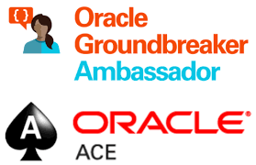

Microservices in real life – with Apache Kafka, Node & Dapr.io Part 2 March 2022
Lucas Jellema Architect & CTO AMIS | Conclusion
Notes:
Wat is een microservice? (waarom, problemen met monolitische applicaties, hoe microservice architectuur, generieke voorzieningen & platform voor microservices, data & events als glue tussen microservices)
Hier alvast stilstaan bij het belang van een event broker en een korte intro van Kafka (meer in college 2)
Implementatie van microservices: afhandelen van http requests, consumeren en publiceren van events, doen van http calls: wat zijn activiteiten die iedere microservice moet uitvoeren? (state mgt, pub/sub, secrets, config mgt, aanroepen 3rd party (cloud) services, ..)
Introductie en demo van Dapr.io framework – de personal assistant die iedere applicatie eenvoudig laat aansluiten op generieke voorzieningen én die applicaties (microservices) met elkaar laat interacteren op ontkoppelde wijze; note: ik zal wijzen op de ondersteuning in Dapr.io voor diverse technologieën zoals RabbitMQ, MySQL, Redis
Handson met Dapr – meegeleverde applicaties in Java en C#
Zelf implementeren van microservice – introductie van NodeJS ;
Handson: afbouwen eenvoudige services in NodeJs en via Dapr.io interactie met elkaar en met generieke voorzieningen

Slide 2

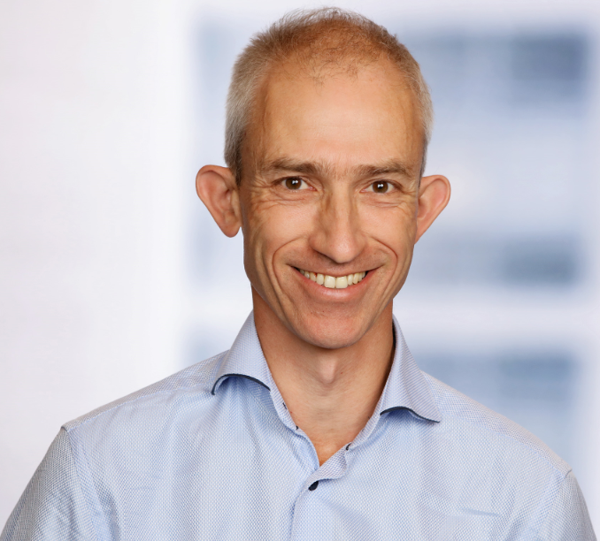


80 colleagues, located in Nieuwegein
Founded in 1991 by students from University of Twente – Aircraft Maintenance Information System (AMIS)
the core of what we do: working with Data.
partnering with peers and companies in several countries
Lucas Jellema (2002)
Cloud Solution Architect & CTO
lucas.jellema@amis.nl | technology.amis.nl | @lucasjellema | lucas-jellema

Slide 3
Data & Application Integration
cloud, DevOps, PaaS, streaming, microservices, Software Studio, database, software engineering
web applications
Data Engineering, Data Analytics (& Data Science)
Oracle, Microsoft Azure, open source, Java, SQL, NodeJS, Python,Kafka React/Angular
Internet of Things

Slide 4
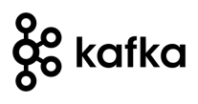













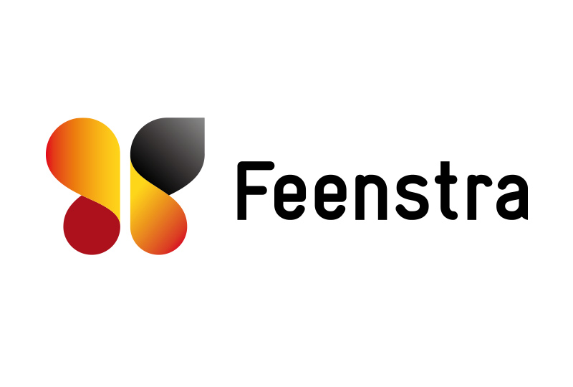

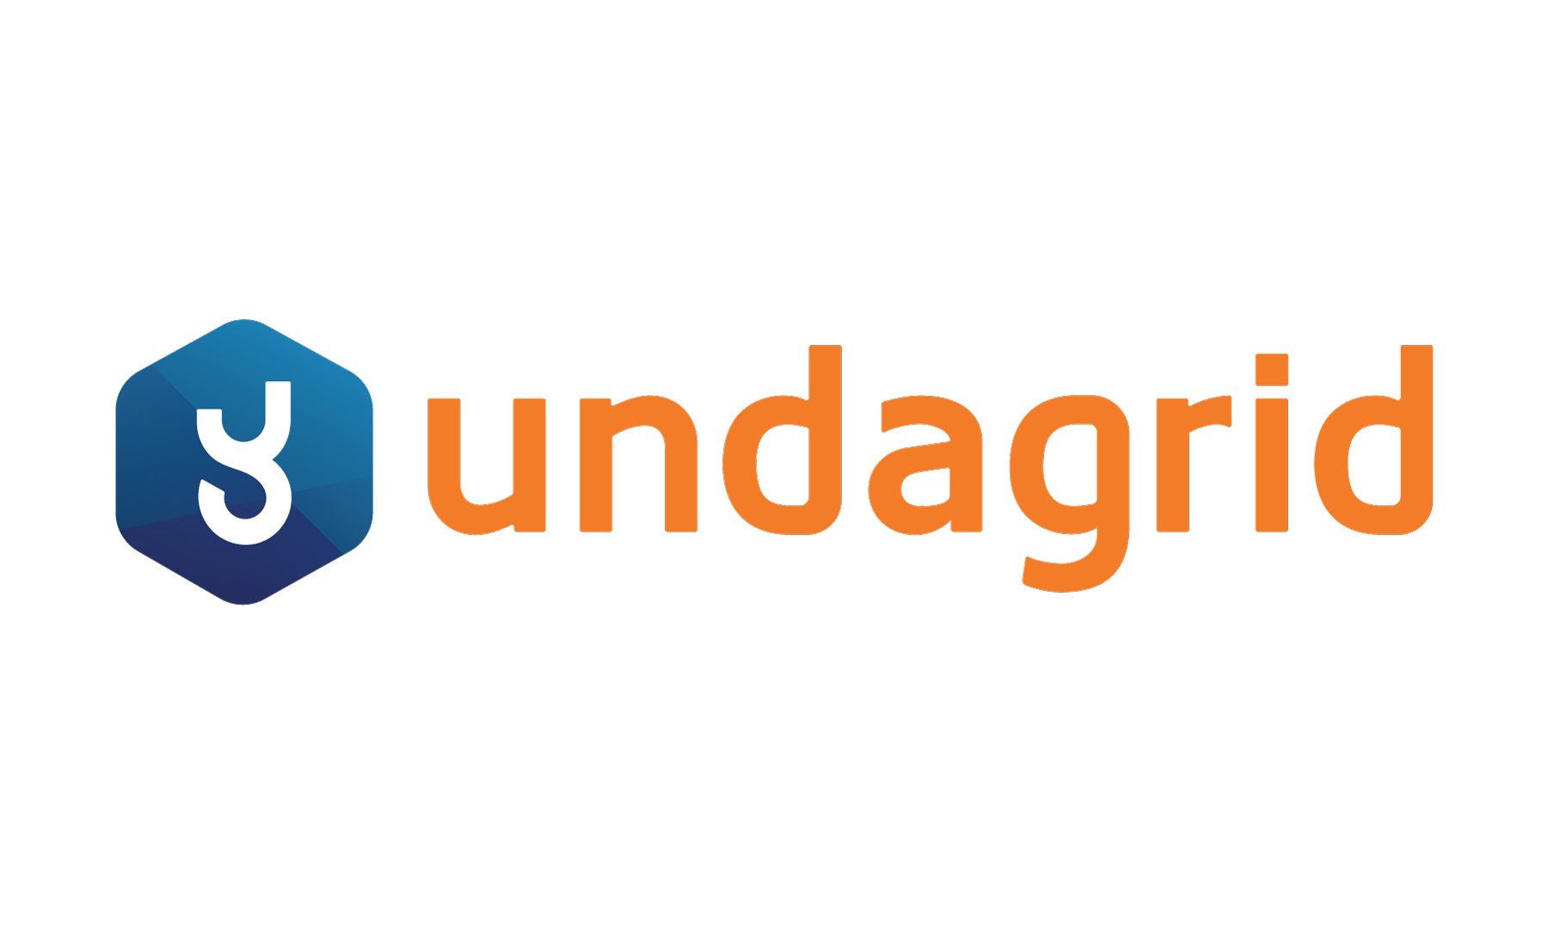











Slide 5
Overview
Part One (last week)
Microservices recap
Dapr.io – personal assistant for applications & distributed application runtime
Handson with Dapr.io
Quick Intro to programming in Node[.js]
Handson Microservice implementation with Node and Dapr.io
Part Two (today)
Introduction of Apache Kafka (“Twitter for systems”)
Asynchronous interactions through Apache Kafka – concepts, terminology
Handson with Apache Kafka and Node
Real world use cases and scenarios with Apache Kafka
Handson Multi-microservice set up with Apache Kafka, Node and Dapr.io

Slide 6
Assumed is
A development environment with VS Code, Docker and Docker Composer, the ability (permissions) to install software
Knowledge of
HTTP, REST, JSON
Containers, Docker (and Kubernetes)
Java or C#
SQL and a database (MySQL or PostgreSQL or SQL Server)
perhaps Message Broker/Event Queue (RabbitMQ?), Cache (Redis?)
Cloud fundamentals
Microservices concepts

Slide 7


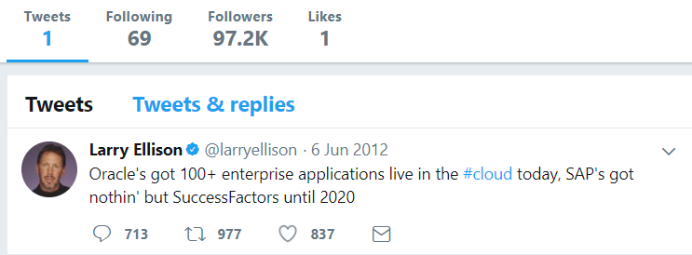
Heck, I do not even know these people and they may not know me [personally] – just my pearls of wisdom. And if they are late to the party, they can also check out the historic archives of my eloquence
Without fretting about the numbers of readers involved and whether they are in the same time zone as me and online when I publish my messages – and which device they use
It would be so nice if I could publish my ideas and actions, accessible near instantly for everyone who is interested

Slide 8
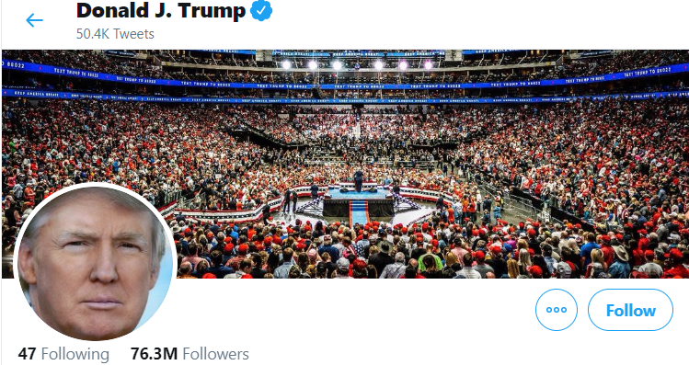
Heck, I do not even know these people and they may not know me [personally] – just my pearls of wisdom. And if they are late to the party, they can also check out the historic archives of my eloquence
Without fretting about the numbers of readers involved and whether they are in the same time zone as me and online when I publish my messages – and which device they use
It would be so nice if I could publish my ideas and actions, accessible near instantly for everyone who is interested

Slide 9
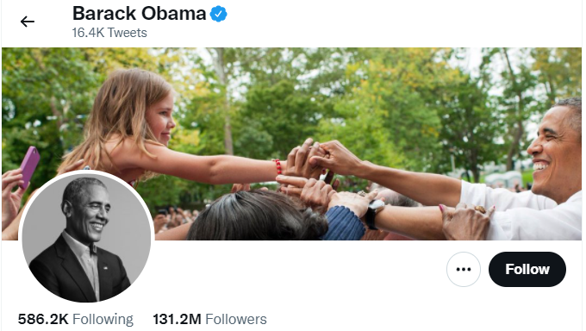
Heck, I do not even know these people and they may not know me [personally] – just my pearls of wisdom. And if they are late to the party, they can also check out the historic archives of my eloquence
Without fretting about the numbers of readers involved and whether they are in the same time zone as me and online when I publish my messages – and which device they use
It would be so nice if I could publish my ideas and actions, accessible near instantly for everyone who is interested

Slide 10

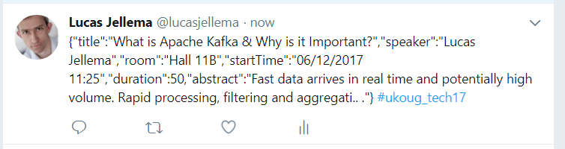
Decoupled communication
0, 1 or many followers
Scalable number of messages (and parties)
Reliable (mostly available, few messages lost)
Full history
Open: cross device, cross location
Not Sub-second, near real-time fast
Rate limited (#messages/minute)
Size limited (140-280 characters)
Format limited (text)
Not for private interactions
Not (really) for programmatic use

Slide 11

What does the Twitter for System Driven Event Interaction look like?
Decoupled communication – organized per topic
0, 1 or many Consumers per Topic
Scalable number of messages (and parties)
Reliable (distributed)
Full history
Open: libraries in many technologies & REST APIs

Slide 12
What does the Twitter for System Driven Event Interaction look like?
Decoupled communication – organized per topic
0, 1 or many Consumers per Topic
Scalable number of messages (and parties)
Reliable (distributed)
Full history
Open: libraries in many technologies & REST APIs
Near real-time fast
No Rate Limit
No enforced size limit
Anything goes (it’s all byte[])
On premises or in cloud, private or trusted
Very much for programmatic use

Slide 13
Events
Consumers
Producers
Robust, QoS, Scalable, Fast, History Retention
Order preserved
Containerized/Cloud-enabled
Open

Slide 14
Messaging as we know it
JMS, IBM MQ, MS MQ, RabbitMQ, MQTT, XMPP, WebSockets, Apache ActiveMQ, …
Challenges
Costs
Scalability (size and speed)
(lack of) Distribution (and therefore availability)
Complexity of infrastructure
Message delivery guarantees (reliability)
Lack of technology openness
Deal with temporarily offline consumers
Retain history

Slide 15


Introducing Apache Kafka
..- 2010 – creation at Linkedin
Message Bus | Event Broker
High volume, low latency, highly reliable, cross technology
Scalable, distributed, strict message ordering, ….
2011/2012 – open source under the Apache Incubator/ Top Project
Kafka is used by many large corporations:
Walmart, Cisco, Netflix, PayPal, LinkedIn, eBay, Spotify, Uber, Sift Science, Zalando, The New York Times, Airbnb, Coursera, ING Bank,…
… and embraced by many software vendors & cloud providers
Commercial backing by and Enterprise support from Confluent

Slide 16
Consumers
tcp
Producers
tcp
Client polls Event Broker for messages

Slide 17
Consumers
Producers
Topic

Slide 18
Kafka terminology
Topic
Message
== ByteArray
Broker
Producer
Consumer
Offset
Message
Key
Value
Time
Producer
Consumer
Broker
Topic
offset (for a specific consumer)

Slide 19
Key
Value
Time
Consumers
Producers
Broker
Topic

Slide 20
Consuming
Messages are available to consumers only when they have been committed by the producer
Kafka does not push
Unlike JMS
Read does not destroy
Unlike JMS Topic
(some | much | all) History available
Offline consumers can catch up
Consumers can re-consume from the past (just move offset)
Delivery Guarantees
Ordering maintained
At-least-once (per consumer) by default; at-most-once and exactly-once can be implemented

Slide 21

The company bulletin board
!
!
!
!!
!!
“@#”

Slide 22



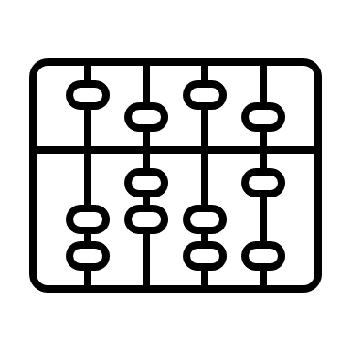

The company bulletin board
!
€
!
!!
“@#$”
$
¥ ₤ ₨

Slide 23
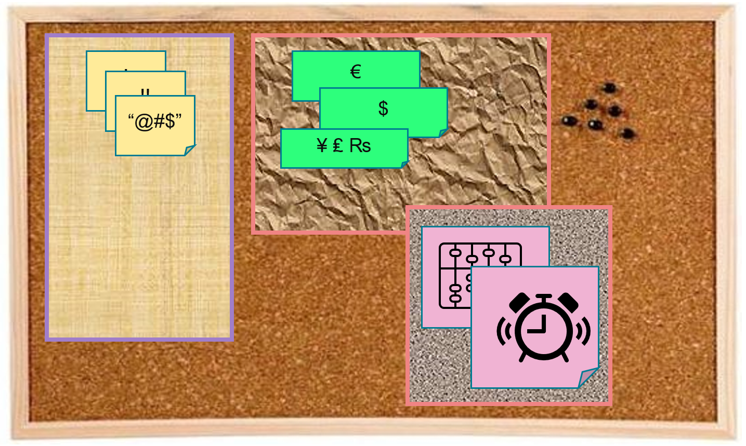
Key
Value
Time
Consumers
Producers
Broker
Topic
Message Log

Slide 24
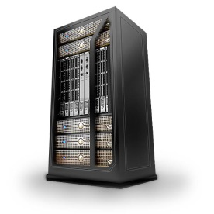

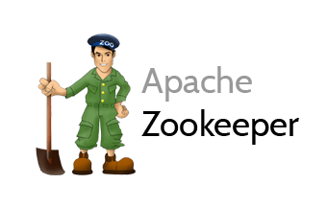
Cluster
Consumers
tcp
Producers
tcp
Broker
Topic

Slide 25
Cluster
Consumers
tcp
Producers
tcp
Broker
Topic
Partition
Consumer Group
Partition Log
Replica

Slide 26
Cluster
Consumers
Consumer Group
each consumer group consumes all messages (once)
each consumer in a group consumes from one or more partitions (no partition is consumed by more than one consumer in a group)
when more consumers in a group than partitions in the topic, some consumers get no messages
when consumers disappear from a group, their partition(s) are reassigned to other consumers in the group
Producers
tcp
Broker
Topic
Partition
Consumer Group
Partition Log
Replica

Slide 27
What’s so special?
Durable transactions
Scalable
High volume
High speed
Parallel processing
Available
Distributed
Open
Quick start
Free (no license costs)
“Self Fulfilling Prophecy” leading to “de facto standard” (positive feedback loop feeding from buzz around Kafka)
Eco system, tools/libraries/resources, cloud services

Slide 28
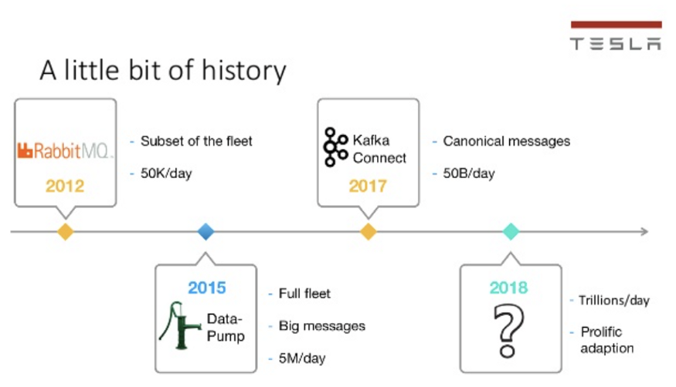
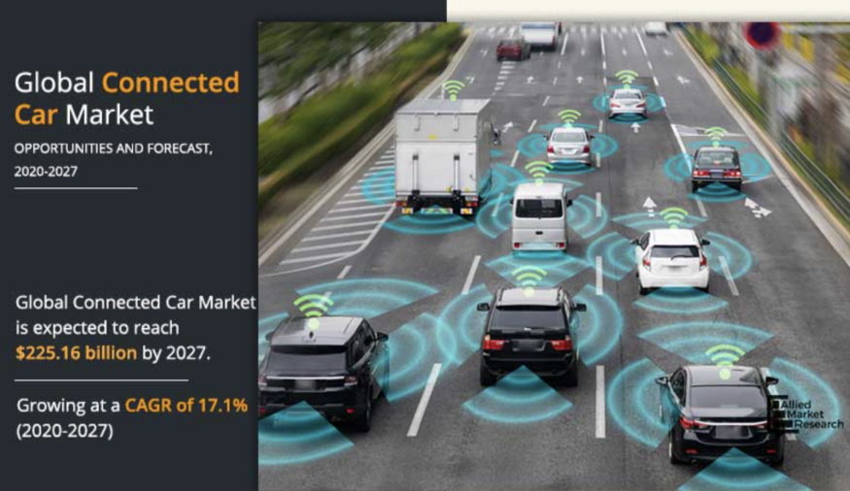
Some Kafka Use Cases
Connected Cars, Manufacturing, Mobility, Gaming, Betting
Tesla: Processing and analyzing the data from their vehicles, smart grids, and factories and integrating with the rest of the IT backend services in real-time is a crucial piece of Tesla’s success
https://kai-waehner.medium.com/when-not-to-use-apache-kafka-a35345226a9f

Slide 29
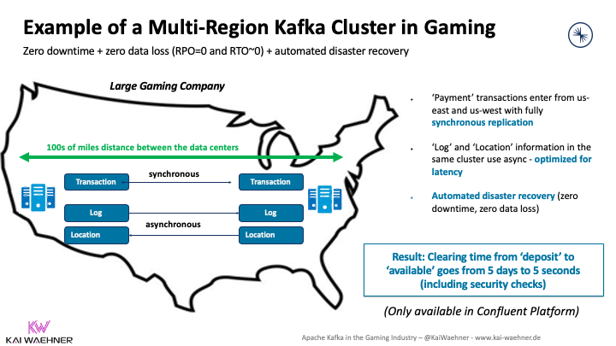
Some Kafka Use Cases
Connected Cars, Manufacturing, Mobility, Gaming, Betting
Regulatory compliance and zero data loss are crucial.
transactionally safe data replication
https://kai-waehner.medium.com/when-not-to-use-apache-kafka-a35345226a9f

Slide 30
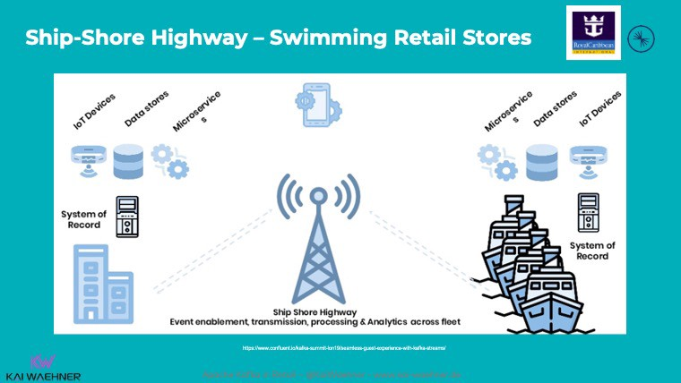
Some Kafka Use Cases
Connected Cars, Manufacturing, Mobility, Gaming, Betting
Royal Caribbean: Each cruise ship has a Kafka cluster running locally for use cases such as payment processing, loyalty information, customer recommendations, etc. Sync with shore when entering a port.
https://kai-waehner.medium.com/when-not-to-use-apache-kafka-a35345226a9f

Slide 31

Quick Demo – Apache Kafka through Kafka Console
Show interaction at the most basic level
Broker
Topic
partition
Produce Message
Consume Message
Consumer Group
9092
Docker Compose
kafka
28042
Browser
Laptop
localhost

Slide 32

Lab: First steps with Apache Kafka
Using Kafka Console
Create a topic
Publish messages to topic
Using Kafka Console
Consume messages from topic
Work with Apache Kafka HQ GUI to
inspect the Kafka Cluster
produce additional messages
consume message from a special Consumer Group
9092
Docker Compose
kafka
28042
Browser
Laptop
localhost
Lab Resources: https://github.com/lucasjellema/fontys-2022-microservices-kafka-dapr

Slide 33
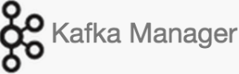

Lab Environment
2181
9092
9093
9094
Docker Compose
kafka
28044
28042
Browser
Laptop
localhost
Lab Resources: https://github.com/lucasjellema/fontys-2022-microservices-kafka-dapr

Slide 34

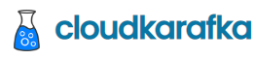
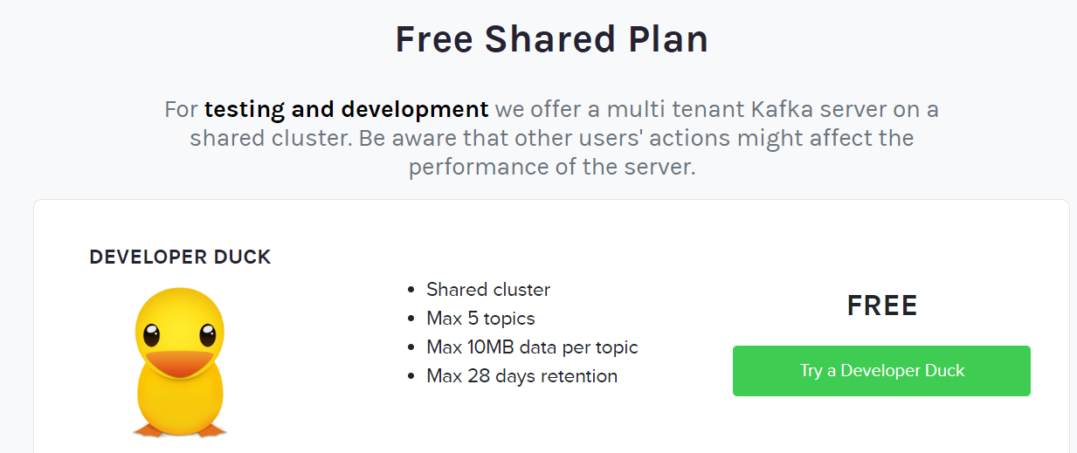
Partly Clouded Lab Environment
2181
CloudKarafka Console
www.cloudkarafka.com/plans.html
Browser
Laptop
localhost
Lab Resources: -

Slide 35
Agenda -
Part One (last week – microservices, Node, Dapr.io)
Part Two (today)
Introduction of Apache Kafka (“Twitter for systems”)
Asynchronous interactions through Apache Kafka – concepts, terminology
Handson with Apache Kafka and Node
Real world use cases and scenarios with Apache Kafka
Handson Multi-microservice set up with Apache Kafka, Node and Dapr.io

Slide 36
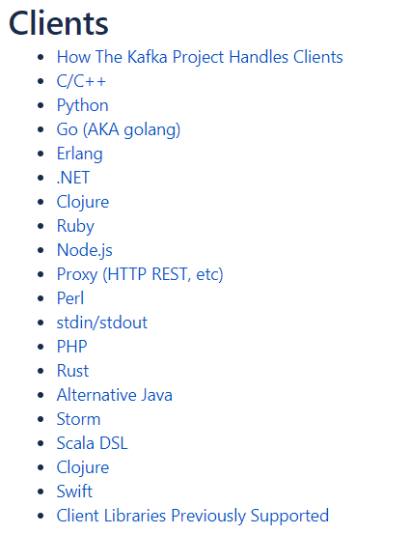



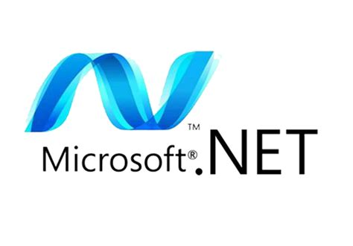

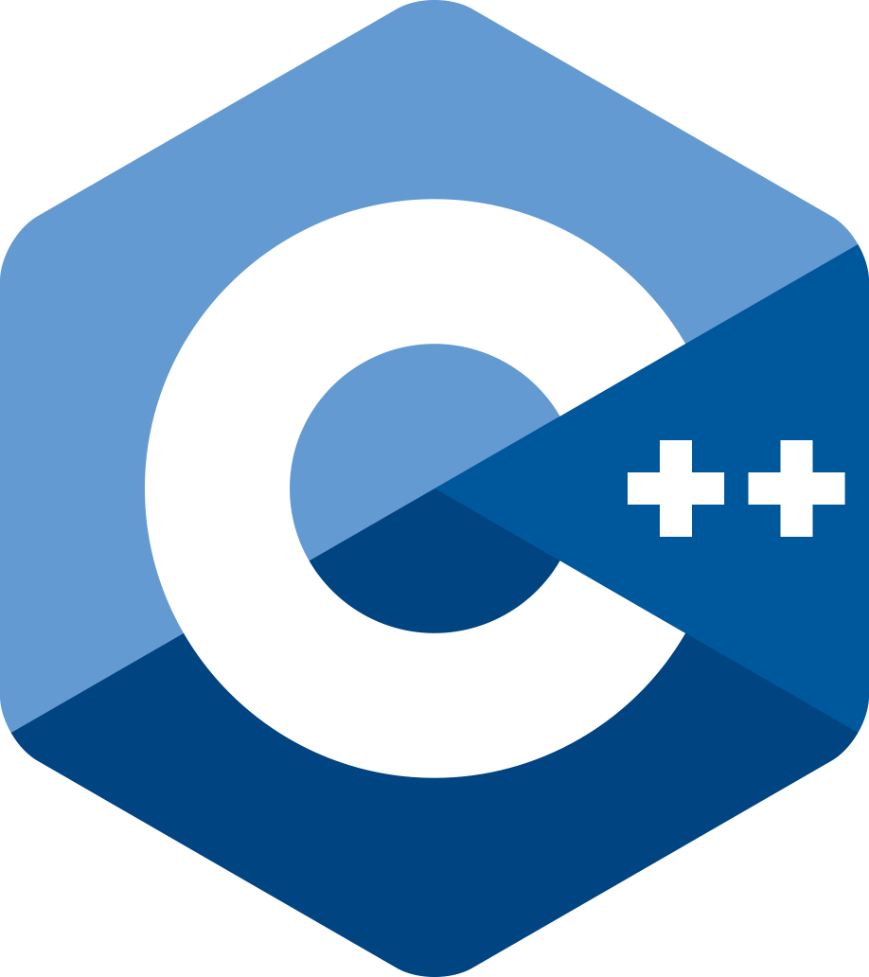





Programming against Kafka: Client Libraries
Client libraries
C/C++
Python
Go
Java
.NET
JavaScript/Node
Ruby
Scala
and more..
Also: REST Proxy (part of open source Confluent Platform)
Produce, Consumer and manage through REST API calls
Notes:
https://cwiki.apache.org/confluence/display/KAFKA/Clients

Slide 37
Programming against Kafka: Typical Steps in a Client Producer Application
Create a connection
connected to one or more brokers in a cluster or to the Zookeeper node
you need the broker-endpoints or the Zookeeper endpoint
optionally use credentials or certificate for authentication
Create a Producer on top of the connection
When the Producer-Connection is available…
[Optionally] Start a Transaction
Produce message[s] to topic(s) [or specific topic partition(s)]
[Optionally] Commit the Transaction
[Repeat Message Production]
Disconnect the producer/close the connection
2181
9092
9093
9094
Client
Application
Notes:
https://cwiki.apache.org/confluence/display/KAFKA/Clients

Slide 38
Programming against Kafka: Typical Steps in a Client Consumer Application
Create a connection
connected to one or more brokers in a cluster or to Zookeeper node
you need the broker-endpoints or the Zookeeper endpoint
optionally use credentials or certificate for authentication
Create a Consumer or a ConsumerStream on top of the connection
Subscribing to one or more topics
[Optionally] Associating with a Consumer Group
(Which leads to a link to one or topic more partitions on the Kafka brokers)
[Optionally] Overriding the auto-commit
When the Consumer or Stream is available…
Consume message[s] (from the specified subscriptions)
[Optionally, depending on auto-commit poperty] Commit the Transaction
[Repeat Message Consumption]
Disconnect the consumer/close the connection
2181
9092
9093
9094
Client
Application
Notes:
https://cwiki.apache.org/confluence/display/KAFKA/Clients

Slide 39
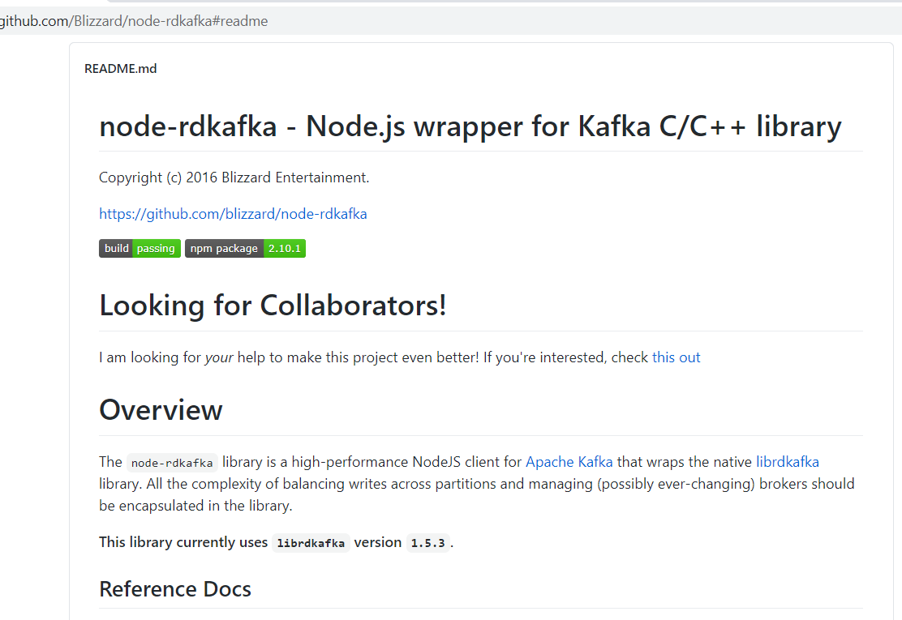
Node and Kafka
We will use NPM module node-rdkafka to facilitate the interaction with Apache Kafka from our Node application
This module leverages a C/C++ library for Kafka interactions

Slide 40
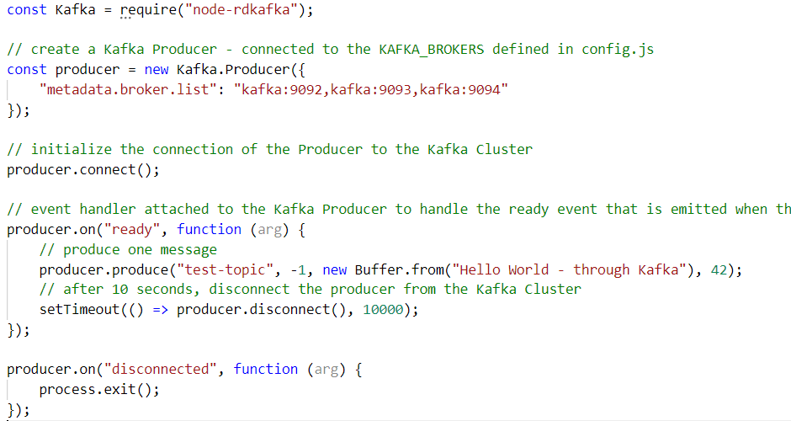
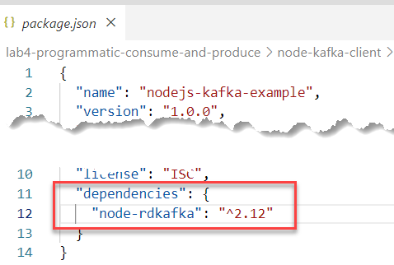
Node and Kafka – a simple producer

Slide 41
Node and Kafka – a simple producer

Slide 42
Node and Kafka – a simple producer

Slide 43
Node and Kafka – a simple producer

Slide 44
Node and Kafka – a simple producer

Slide 45
Node and Kafka – a simple producer
test-topic
9092
9093
9094
2
1
Client
Application

Slide 46
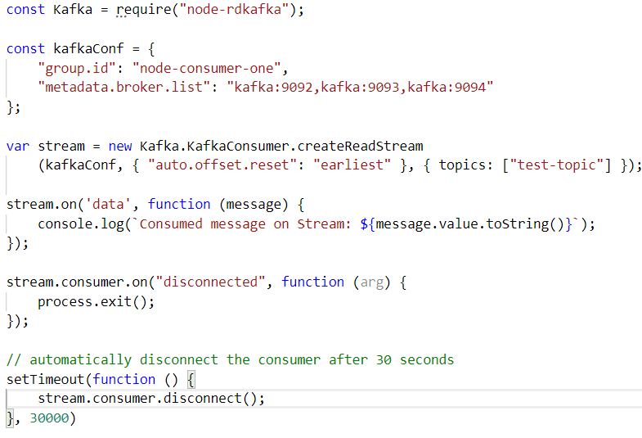
Node and Kafka – a simple consumer
test-topic
9092
9093
9094

Slide 47
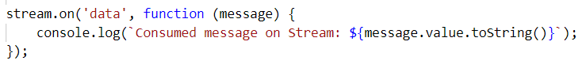
Node and Kafka – a simple consumer
test-topic
9092
9093
9094
1
2
Client
Application

Slide 48
Lab – Programmatic interaction with Apache Kafka
Prequisite: local Node runtime
Step Two:
Node application to Produce Messages to Kafka Topic
Node application to Consume Messages from Kafka Topic
Bonus Step Three:
Node Web Application to Produce Messages from HTTP Request
Node Web Application to return Messages on Topic in HTTP Response

Slide 49
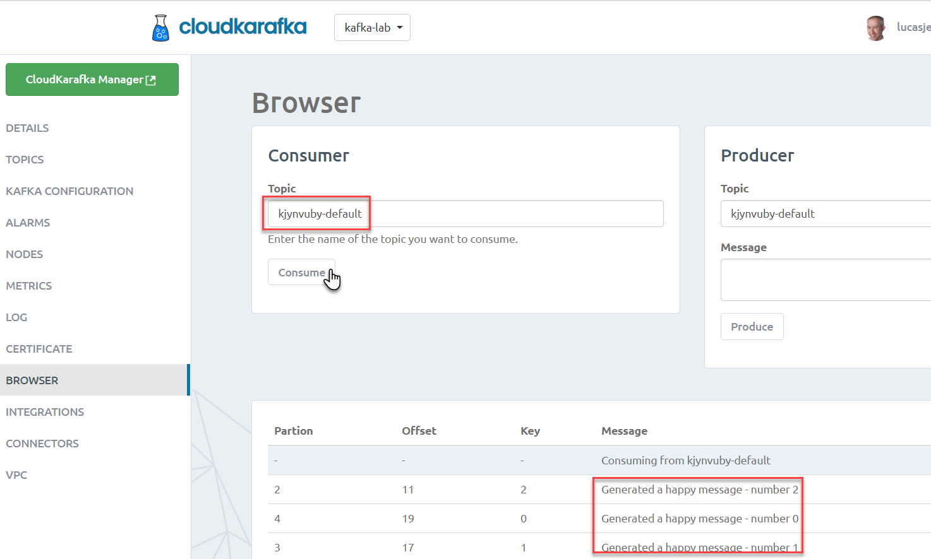
kjynvuby-default
Consume
Produce

Slide 50
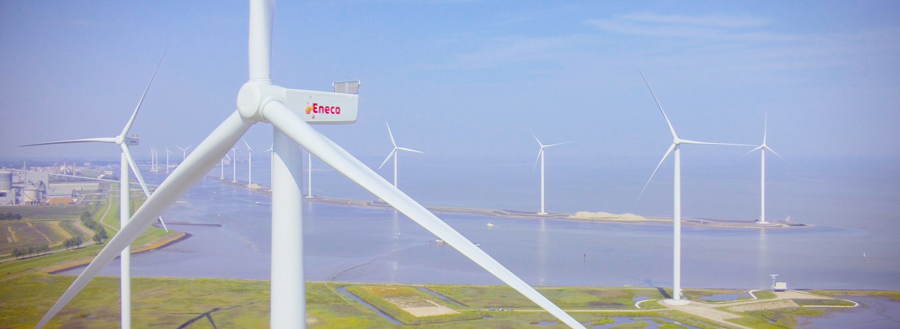
Utility company with data. Lots of it.
Interesting mix of operational, real time systems in physical environments, large scale enterprise systems for 1000s of internal professionals and millions of external consumers – with a mission to improve the world

Slide 51









Utility Company looking for Performance, Scalability and Availability in their core data sets
Marketing Campaigns
Invoicing
CRM
Billing
batch
Meter Readings
Load on Core Systems & effect on Performance
Availability Core Systems

Slide 52
Utility Company looking for Performance, Scalability and Availability in their core data sets
Marketing Campaigns
CRM
Invoicing
CRM Cache DB
Meter Readings
Billing
Meter Readings Cache DB

Slide 53

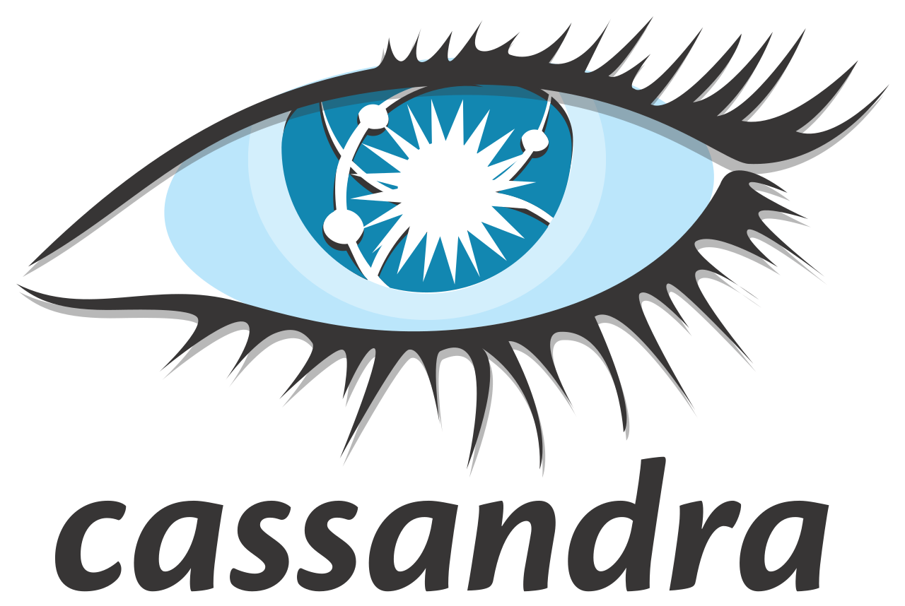
Utility Company looking for Performance, Scalability and Availability in their core data sets
Marketing Campaigns
CRM
Invoicing
CRM Cache DB
Meter Readings
Billing
Meter Readings Cache DB

Slide 54
Practical Challenges
Marketing Campaigns
Publish all change events from sources
Event schema evolution
Lag in Cache Databases
“eventual consistency”
Differences between sources and cache databases
Initial creation of Cache Databases
General Scale and Incidental event storm
Business and Mission Critical availability
Data Authorization
Logic enforced in source (applications)
GDPR
CRM
Invoicing
CRM Cache DB
Meter Readings
Billing
Meter Readings Cache DB

Slide 55
Event Sourcing

Slide 56
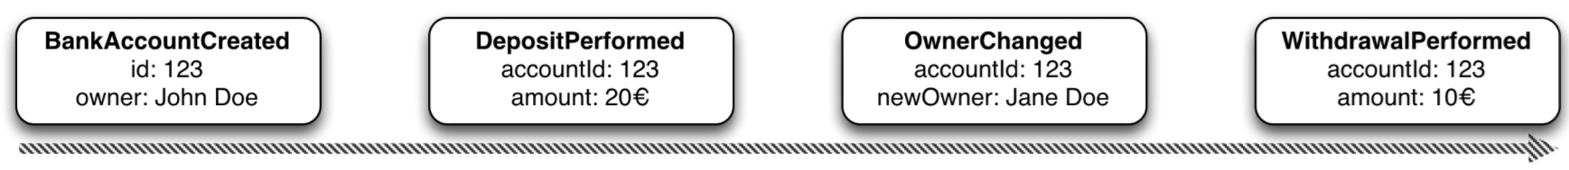


Event Sourcing
amount: 10
Owner: Jane Doe
Events
Current State
Event Store
accountId: 123
Notes:
Events are immutable facts
Current state (active record) is derived from sum of events
Read optimized aggregates are created for specific use case – based on events and rebuildable at any time

Slide 57
Event Sourcing
Events
Current State
Event Store
Other State Aggregate
Notes:
Events are immutable facts
Current state (active record) is derived from sum of events
Read optimized aggregates are created for specific use case – based on events and rebuildable at any time

Slide 58
Event Sourcing
Event Store is immutable – append-only log of domain state transitions
It is the truth about data – everything else is derived
Replay events
to (re)construct a representation of the current state (aggregate)
up to a specific time to recreate moments in time
in Test environment to investigate an issue
on a remote location to create mirror & share state across boundaries
produce a fine grained audit trail
Challenges
Time required to reconstruct state
Grain of aggregates / definition of domain events

Slide 59
Retail chain – 1200 stores and one central environment
Store D
Store C
Central Environment
(on Azure)
Store B
Store A

Slide 60
Retail chain – 1200 stores and one central environment
fast
capable of high volume
reliable / transactional
cross technology
not invasive
future proof (and proven)
bi-directional
Store D
Store C
Central Environment
(on Azure)
Store B
Store A

Slide 61
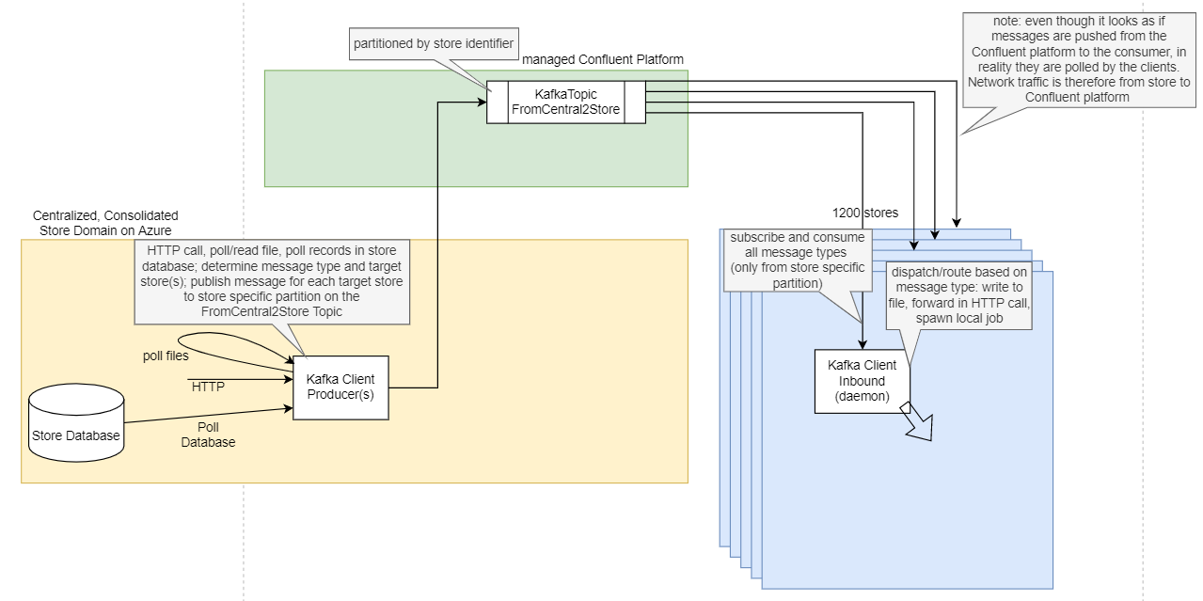
Outbound – from central to 1200 stores
Store D
Store C
Central Environment
(on Azure)
Store B
Store A

Slide 62
Outbound – from central to 1200 stores
Store D
Store C
Central Environment
(on Azure)
Store B
Store A

Slide 63
Retail chain – 1200 stores and one central environment
Store D
Store C
Central Environment
(on Azure)
Store B
Store A

Slide 64
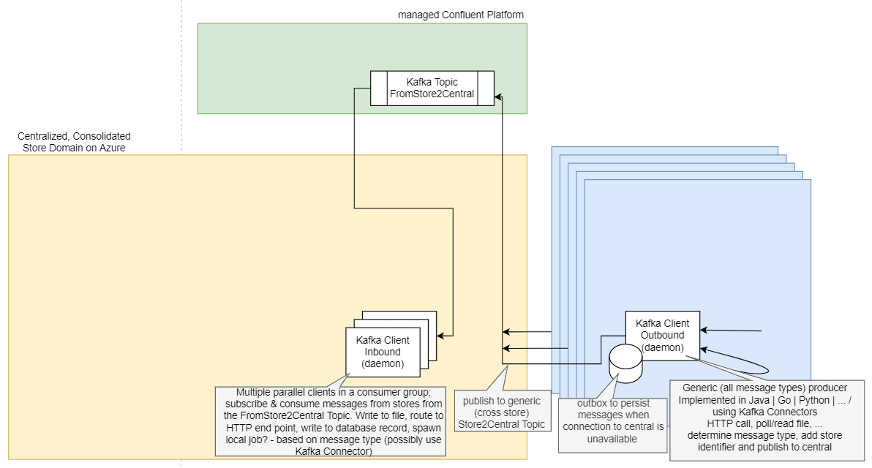
Inbound – from 1200 stores to Central
Store D
Store C
Central Environment
(on Azure)
Store B
Store A

Slide 65
Inbound – from 1200 stores to Central
Store D
Store C
Central Environment
(on Azure)
Store B
Store A

Slide 66


Web Portal – Faster, Simpler and more Available
Lab Systems
Web Portal
?

Slide 67
Web Portal – The Original Situation (2014)
Lab Systems
Web Portal
Service Bus
SOAP/XML
Relational Database
SQL & Stored Procedures

Slide 68

Web Portal – Faster, Simpler and more Available (2021)
Lab Systems
Web Portal
Service Bus
SOAP/XML
REST/JSON
NoSQL Database
Azure Cloud
Relational Database
Changed Data Capture
Kafka
Kafka Connect

Slide 69
Apache Kafka is more than the core distributed platform And there is more to distributed event platforms than Kafka
Apache Kafka is surrounded by an ecosystem
Primary supporting company: Confluent
Extensions, Tools, Enterprise Edition
Supporting resources (books, articles, tutorials, conferences)
Partner companies
Managed cloud services
Kafka-compatible Public Cloud offerings
Kafka-like offerings
Competitors, imitators, …

Slide 70
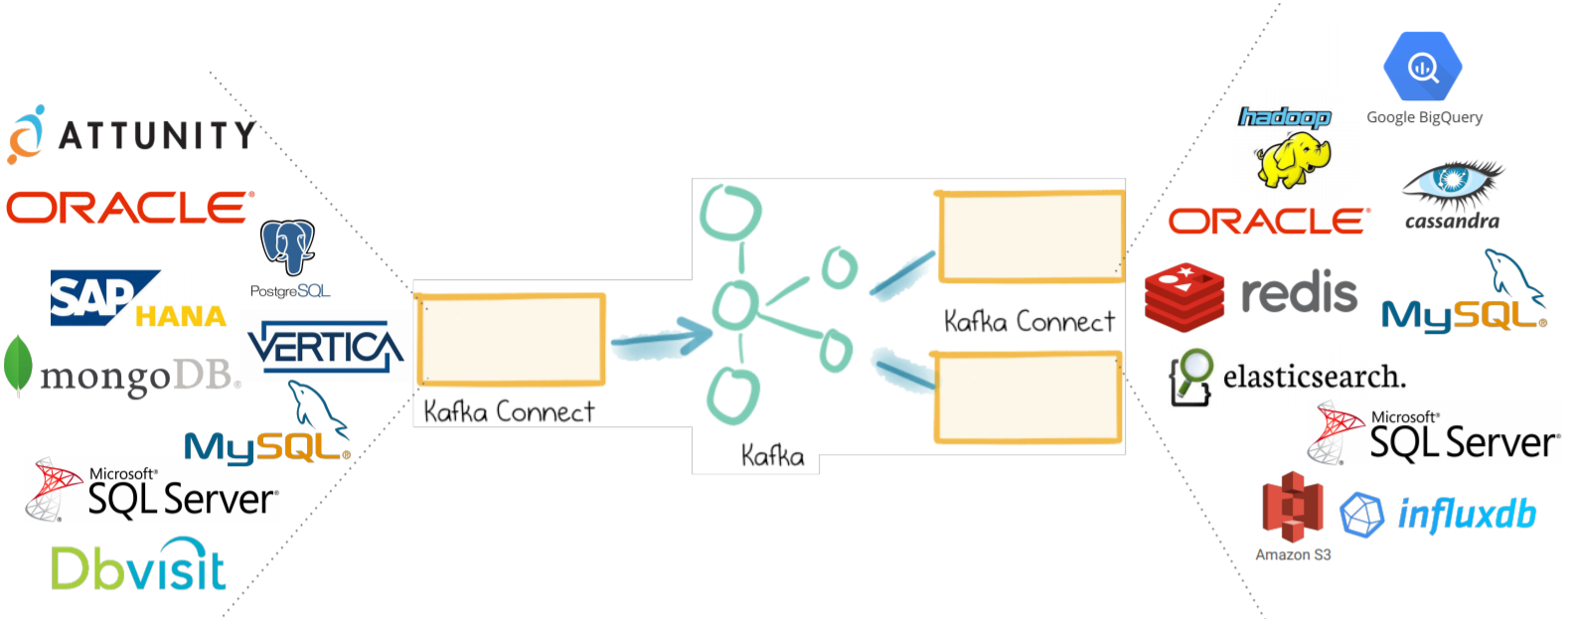
Ecosystem – Kafka and Friends
Kafka Schema Registry – manage message schema definitions
Kafka Connect – read data and change events from many sources and/or write to many targets
Also see Debezium
Kafka Streams
Kafka KSQL
Confluent Enterprise
Enterprise Grade Security
Replicator (synch across regions)
Ops (Operations) support
Confluent Managed Kafka Cloud Offering

Slide 71
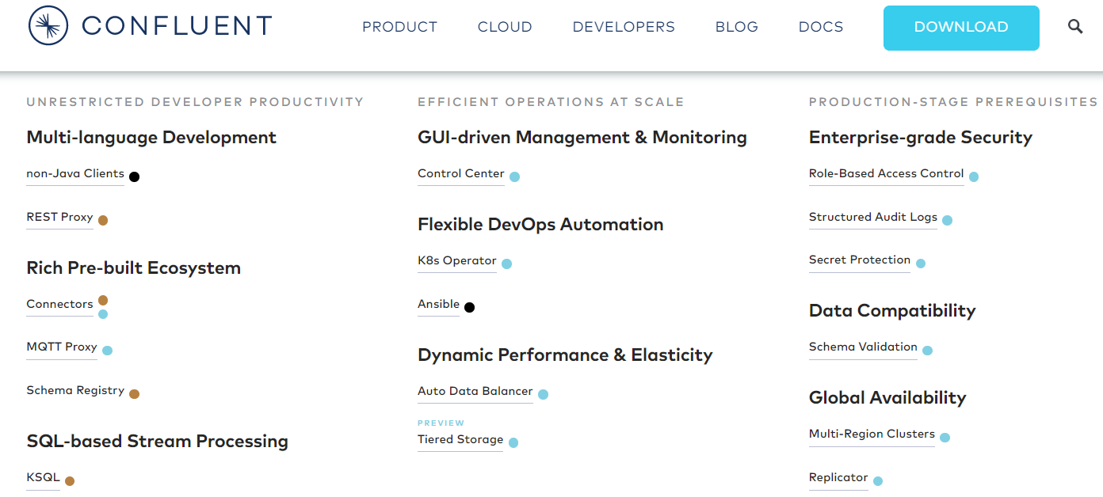
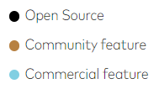
Confluent offerings

Slide 72

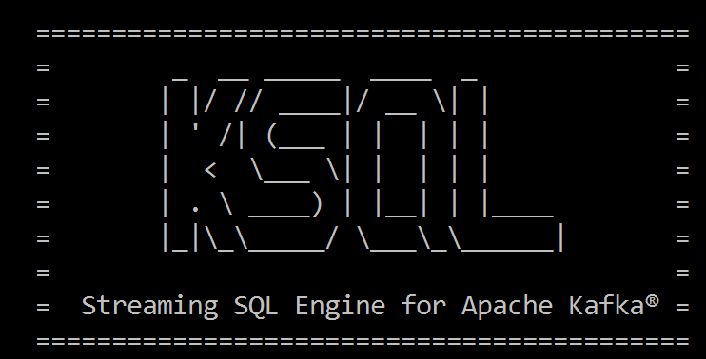
Select Running Count from <stream of tweet events>
select tag
, count(*) tweet_count from tweets Where tag = 'COVID2019' or tag = 'KAFKA'
group by tag
<--- streaming data

Slide 73

Continuous Queries on Streaming Data
Count Events, Aggregate Payloads, Filter, Combine & Enrich…
… and produce: new events
Topic
Processor
Topic
Topic
Processor
Topic
Table

Slide 74



Alternatives for Apache Kafka’s Distributed Streaming Event Platform
Apache Pulsar
Solace PubSub+ Event Portal
Rabbit MQ
Apache Active MQ
Streaming Data libraries
Apache Spark Streaming, Conduit, Faust, Apache Flink, Apache Storm, Samza, Apache Beam, Apache Flume

Slide 75
Managed Kafka (-like) Cloud Offering
Confluent
AWS
SQS
Managed Streaming for Apache Kafka (Amazon MSK)
EventBridge, Kinesis
Azure
Event Hub
EventGrid, Stream Analytics
Oracle Cloud Infrastructure
Streams
Google Cloud Platform
PubSub
DataFlow
… (Heroku Managed Kafka, Alibaba Cloud LogHub, IBM Event Streams,…)
?

Slide 76
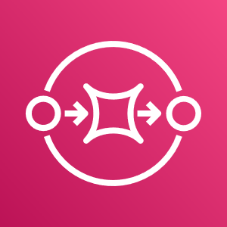



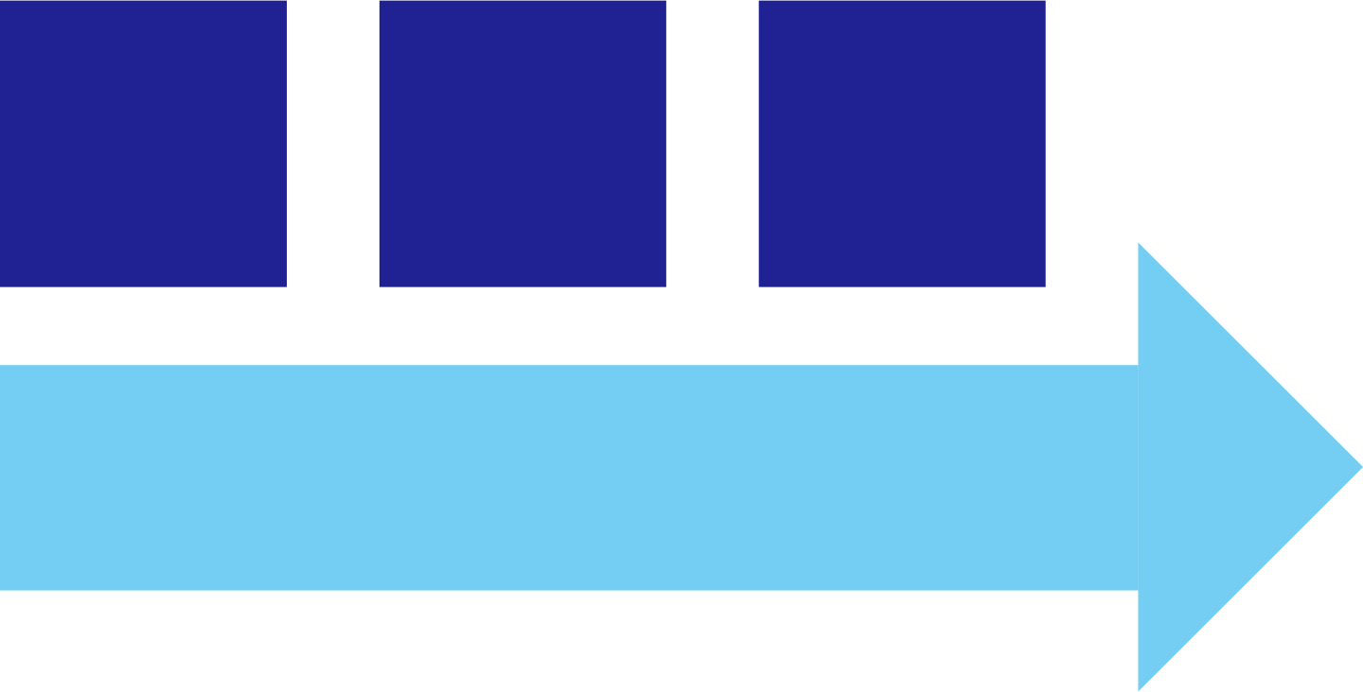



Slide from last week: Pub/Sub with Dapr from Node applications
PubSub
Brokers
AWS
SQS
Azure
Service Bus
GCP
Pub/Sub
Redis
RabbitMQ
pub/sub interface
Pub/Sub components
message sent to handler
Node SDK for Dapr
Node SDK for Dapr
publish message
subscribe on topic with handler function
components.yaml
sidecar (the personal assistant)
components.yaml

Slide 77
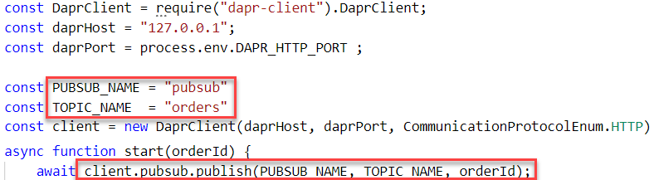
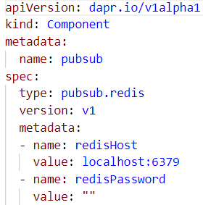
Pub/Sub with Dapr from Node applications
PubSub
Brokers
AWS
SQS
Azure
Service Bus
GCP
Pub/Sub
Redis
RabbitMQ
pub/sub interface
Pub/Sub
components
publish message
message sent to handler
Node SDK for Dapr
Node SDK for Dapr
publish message
subscribe on topic with handler function
components.yaml
sidecar (the personal assistant)
components.yaml

Slide 78
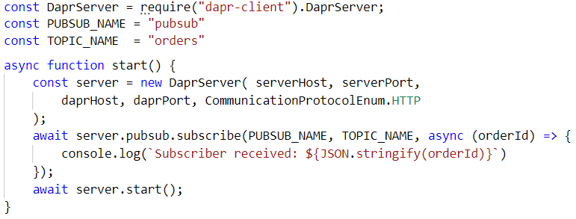
Pub/Sub with Dapr from Node applications
PubSub
Brokers
AWS
SQS
Azure
Service Bus
GCP
Pub/Sub
Redis
RabbitMQ
message sent to handler
pub/sub interface
subscribe on topic
Pub/Sub
components
Node SDK for Dapr
Node SDK for Dapr
publish message
components.yaml
sidecar (the personal assistant)
components.yaml

Slide 79
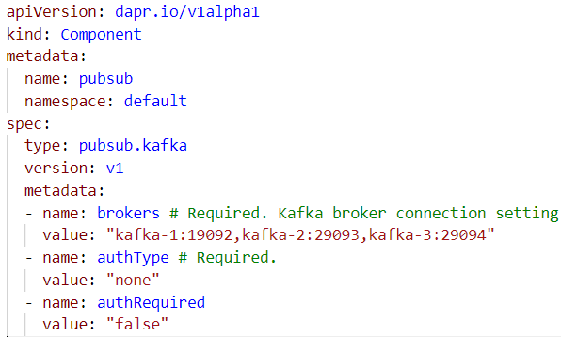
Pub/Sub with Dapr from Node applications Replace Redis by Apache Kafka
test-topic
9092
9093
9094
PubSub
Brokers
Redis
RabbitMQ
pub/sub interface
Pub/Sub components
message sent to handler
Node SDK for Dapr
Node SDK for Dapr
publish message to topic
subscribe on topic with handler function
components.yaml
sidecar (the personal assistant)
components.yaml

Slide 80
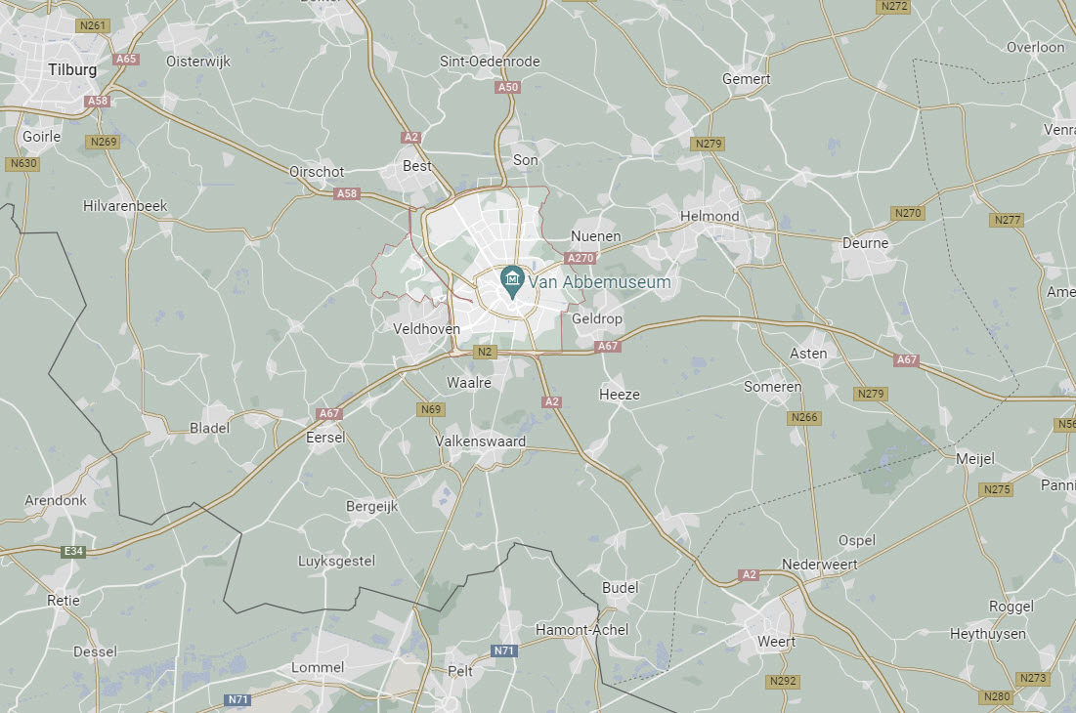






Inter-student (laptop/application) communication
Student Y
Student X
Student Z

Slide 81

Inter-student (laptop) communication Node-Dapr => Cloud Karafka => Dapr-Node
Student Y
Consume
Student X
Student Z
Produce
Consume

Slide 82
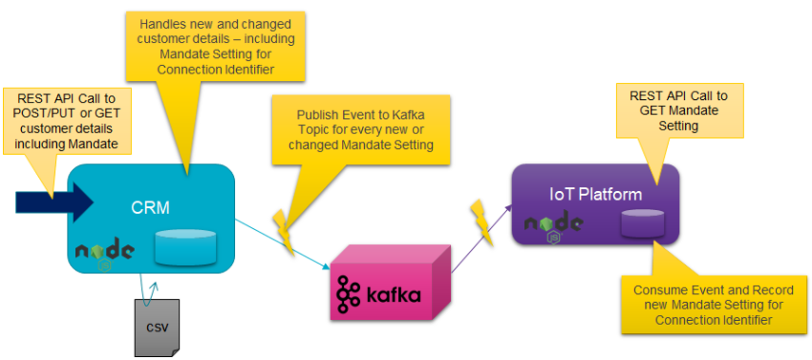
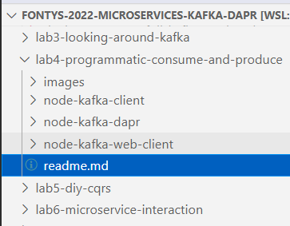

Labs on Kafka and Node and Dapr
Programmatically work with Kafka from Node – with and without Dapr
publishing and consuming messages
Implement the CQRS pattern between two microservices
one is master of data, the other has a stand alone replica – to be synchronized
Implement decoupled conversation between multiple microservices – through Kafka
Billing Run Coordinator
1
Create bill processing instructions for customers
Handles assignment on workflow queue to produce a bill for a customer
2
workflow-queue
CRM
Billing Engine
3
questions
5
answers
4
Publish Event to Kafka Topic with question details and conversation identifier
Consume Event, handle the question and publish a response with customer details on a second queue – including the conversation identifier
bill

Slide 83
Lab – Microservice interaction
Billing Run Coordinator
1
Asynchronous conversation between microservices
Create bill processing instructions for customers
Handles assignment on workflow queue to produce a bill for a customer
2
workflow-queue
CRM
Billing Engine
questions
3
answers
4
5
Consume Event, handle the question and publish a response with customer details on a second queue – including the conversation identifier
Publish Event to Kafka Topic with question details and conversation identifier
bill

Slide 84

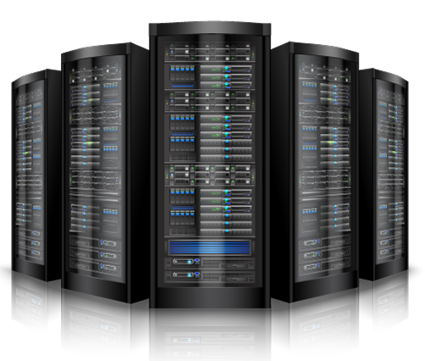

Summary
=> == =>
Apache Kafka is emerging as platform of choice for message exchange in a world of
Microservices
Event Sourcing, CQRS and Data Source Synchronization
Clouds
Fast Data (IoT) and Streaming Analysis
Real time data integration & distribution
Getting started with Apache Kafka is not very hard at all
The platform is open source – and has broad client support (Java, Node, …)
Many resources are available – tutorials, blog article, demonstrations, presentation slides and recordings of conference sessions, samples on GitHub
Using Docker Compose it is quite easy to quickly run a Kafka Cluster (and with CloudKarafka even easier)
Note: managing a production grade cluster is not so easy

Slide 85

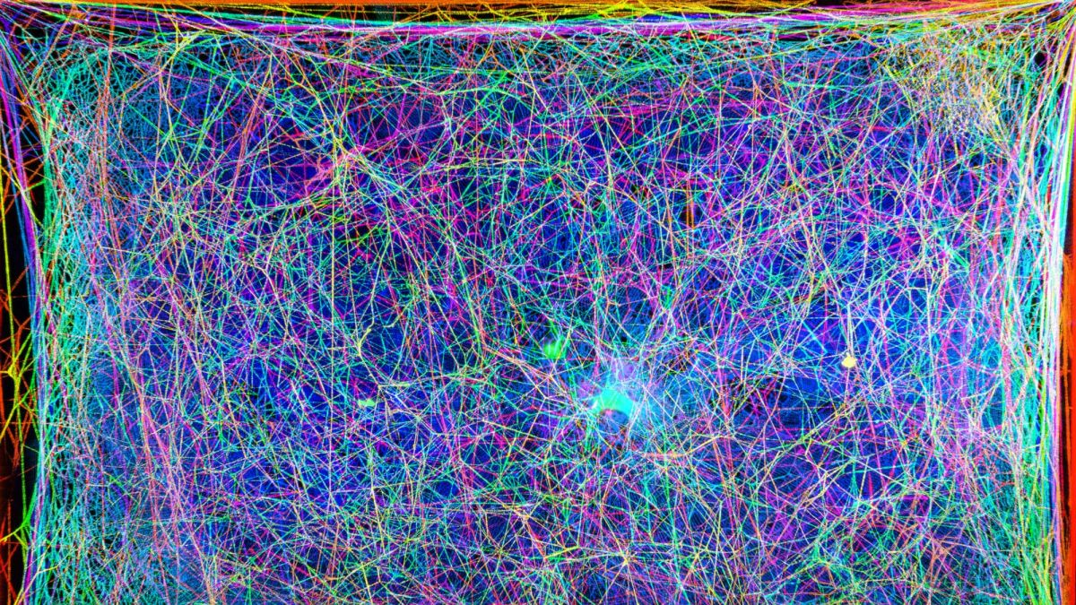
























lucas.jellema@amis.nl | technology.amis.nl | @lucasjellema | lucas-jellema
you are invited to come do an internship and explore job opportunities with us!

